Slide 1

Green Pace
Security Policy Presentation
Developer: Hunter Ashner

Slide 2

OVERVIEW: DEFENSE IN DEPTH
Defense in depth describes the segmented approach of security needed to protect an organization at multiple levels through robust distributed security practices

Slide 3
THREATS MATRIX
STD-001-CPP STD-INT31-C | STD-INT31-C STD-STR02-C STD-CTR53-CPP
STD-DCL03-C STD-EXP51-CPP STD-DCL12-C | STD-DCL12-C STD-MEM11-C

Slide 4
10 PRINCIPLES
Validate Input Data
Heed Compiler Warnings
Architect and Design For Security Policies
Keep It Simple
Default Deny
Adhere to the Principle of Least Privilege
Sanitize Data Sent to Other Systems
Practice Defense In Depth
Use Effective Quality Assurance Techniques
Adopt a Secure Coding Standard

Slide 5
CODING STANDARDS
Validating input, especially in type unsafe languages like C, protects from buffer overflows and other runtime errors, as well as attacks like SQL-Injection.
Heeding compiler warnings is the first defense for patching any holes or security vulnerabilities in an application.
Beginning the design process with an emphasis on security closely integrates security and best practices directly into an applications code base.
Simplicity and decoupled code saves time, increases readability, and reusability of code.
By denying access by default and only authorizing access when utterly necessary systems are kept more secure.
By sanitizing data before passing, it to other systems we are creating a second data verification process and protecting partnered systems simultaneously.

Slide 6
ENCRYPTION POLICIES
Data at rest should be encrypted if it contains any identifying or confidential information. Robust cipher algorithms like AES128/256 are optimal to protect data from brute force attacks.
Usage Of inherently suboptimal plain text protocols should be always avoided. FTP, Telnet, and HTTP pass data over networks without encryption. This could cause easy avenues for attack as local networks thought to be safe from surveillance could be used to gain unencrypted user information.
Remote offices and home users should only be accessing company resources via encrypted VPN tunnels. Newer standards like OpenVPN and Wireguard offer robust encryption with faster speeds than their predecessors.

Slide 7
TRIPLE-A POLICIES
Authentication is the backbone of any company’s network and data security layers. Users should utilize TOTP applications along with robust access credentials for the strongest protection.
Authorization is paramount to determine when access to specific resources should be granted, authorization should be checked frequently or with every request made to access secured data.
Accounting allows a security team to track any unauthorized or potentially malicious access to private data and systems. Often strange behaviors can be detected just from intelligent logging.

Slide 8
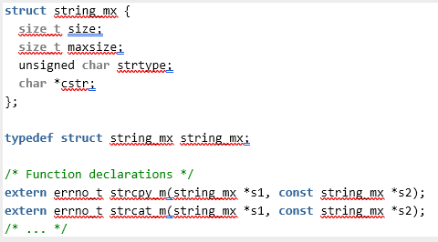
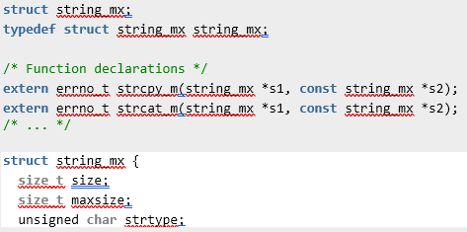
Unit Testing
Architect & Design for Security Policies
Data Type – STD-DCL12-C – Implement abstract data types using opaque types.
Developers are more likely to directly manipulate size and maxSize of string_mx violating the principles of information hiding.
In the compliant example two header files are created to hide the implementation of the data type from the users of the managed string library.
NON-COMPLIANT
COMPLIANT

Slide 9
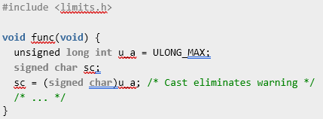
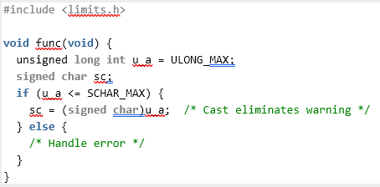
Unit Testing
Architect & Design for Security Policies
Data Value – STD-INT31-C – Ensure that integer conversions do not result in lost or misinterpreted data.
Type range errors like loss of data and loss of sign can occur when converting from a value of unsigned integer to signed integer. By validating ranges before converting from unsigned to signed int prevents loss of data and loss of sign errors.
NON-COMPLIANT
COMPLIANT

Slide 10

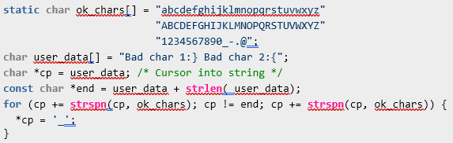
Unit Testing
Validate Input Data
SQL Injection – STD-STR02-C – Sanitize data passed to complex systems, inclusion of special characters could have undefined behaviors in complex systems.
Special characters are allowed resulting in undefined behavior or malicious code injection to complex subsystems. Creating an array of valid characters allows the application to easily filter out special characters that may have undefined results on complex subsystems like SQL databases.
NON-COMPLIANT
COMPLIANT

Slide 11
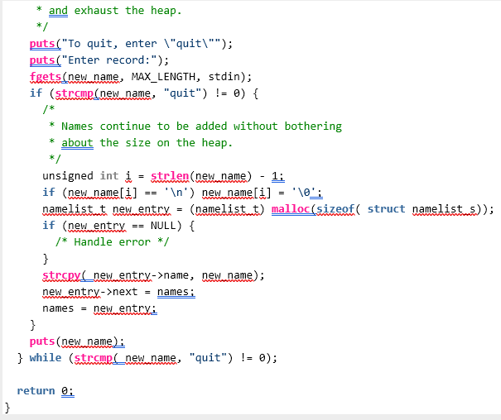
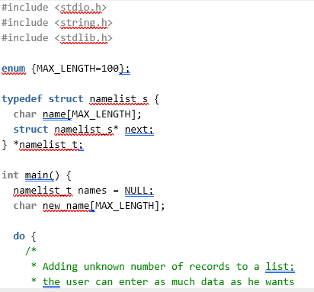
Unit Testing
Architect & Design for Security Policies
SQL Injection – STD-MEM11-C – Do not assume infinite heap space.
Because no bound is placed on memory, an undetected memory leak could exhaust the entire heap leading to computer failure, crashes, or other undefined behavior. If heap exhaustion is a potential after code refactoring, storing large amounts of data to the disk may be a more manageable solution for handling the large amounts of data.
Writing data to a simple database file could potentially resolves issues with memory exhaustion.
NON-COMPLIANT
COMPLIANT

Slide 12

AUTOMATION SUMMARY

Slide 13
TOOLS
DevSecOps refers to any software development system that starts with security principles in place and thoroughly integrates these systems during each iterative step of the software design process.
By integrating security into the continuous integration environment, vulnerabilities are fixed before their deployment.
By collecting user input and monitoring/logging usage info and statistics information can be gathered and patches can be made to fix bugs and other vulnerabilities in a codebase.

Slide 14
RISKS AND BENEFITS
Act now or wait is a fine line danced by many organizations and DevSecOps teams. Often deciding between fixing a vulnerability immediately or leaving it vulnerable to attack comes down to the number of other vulnerabilities that may be more important to patch as well as the budget and staffing an organization has available to dedicate to make these changes immediately.

Slide 15
RECOMMENDATIONS
People are usually the easiest means of access into any organization. In addition to network security principles, secure coding practices, and DevSecOps processes, physically protecting company data and systems is another important step in protecting software systems. By locking server rooms, server racks, and NAS devices, data can be kept secure from any physical interaction.
Creating an environment of security in an organization is an important step in protecting company networks and systems from unauthorized access.

Slide 16
CONCLUSIONS
Be prepared to change protection strategies.
Have resources and staff to take immediate action.
Prioritize high likelihood and high severity vulnerabilities first.
Begin development with security principles in mind.
Security starts at home, and protecting assets physically is just as important as securing a codebase.

Slide 17
REFERENCES
Seacord, R. C., & Pethia, R. D. (2015). Secure coding in C and C++. Addison-Wesley.

